Slide 1

Evaluation of an ASP Prospect
Lei Ding
José López Salinas
Maura Puerto
Clarence A. Miller
George J. Hirasaki
17th Annual Meeting
Consortium for Processes in Porous Media
2013-04-29
Notes:
Great honor to have the opportunity to give presentation here. My presentation is Evaluation of an Alkaline/surfactant/polymer prospect, Oil company approached us; develop process, assess a particular surfactant blend recommended by another organization; something interesting in phase behavior test; new project, question not be resolved, next year, honestly invitation

Slide 2
Outline
• Crude Oil Contamination Test
• Phase Behavior with NaOH and Na2CO3
Surfactant Free Samples
In the Presence of Surfactant
• Conclusions and Future Work
Notes:
At first, some test were conducted to check if the oil sample is free of contamination; many phase behavior test were conducted to investigate he influence of alkali, surfactant, salinity on phase behavior. two series of phase behavior test;

Slide 3
Outline
• Crude Oil Contamination Test
• Phase Behavior with NaOH and Na2CO3
Surfactant Free Samples
In the Presence of Surfactant
• Conclusions and Future Work
Notes:
Let is look at the contamination test at first

Slide 4
IFT Measurement for Crude Oil at 25°C
IFT of Oil Against DI Water
IFT of Oil Against 1% NaCl Solution
Oil was centrifuged before testing;
This crude oil sample is considered uncontaminated because IFT > 20 mN/m.
Notes:
Method to determine, criteria, drilling and oil-field chemicals, many of which are surface active, reaches plateau at 22.5

Slide 5
Outline
• Crude Oil Contamination Test
• Phase Behavior with NaOH and Na2CO3
Surfactant Free Samples
In the Presence of Surfactant
• Conclusions and Future Work
Notes:
Two series, some of them are surfactant free samples, others are phase behavior of surfactant with either Na2CO3 OR NaOH; to investigate the influence of soap, surfactant, and salinity

Slide 6
In the Absence of Surfactant
Na₂CO₃ 0-5% Wt/Wt
NaOH 0-2% Wt/Wt

Slide 7
Procedures
All samples prepared are surfactant-free samples.
Samples were
first rotated end-to-end for 24 hours,
left standing for equilibration,
taking photos at different times.
then immersed in tubes filled with water,
located in water bath at 130°F,
mixed daily, many times, for 1 week,
left standing before being photographed.
Notes:
After the pipette has been sealed,

Slide 8
Na₂CO₃
0-5% Wt/Wt

Slide 9
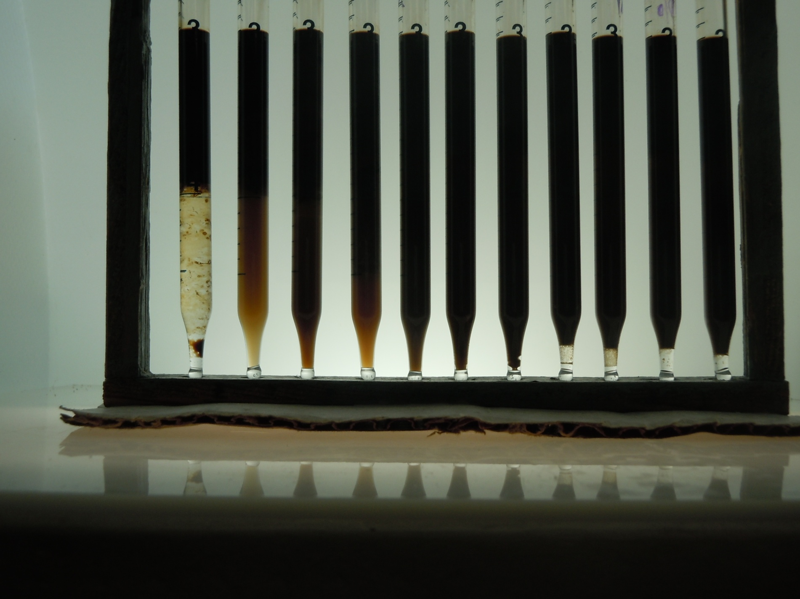
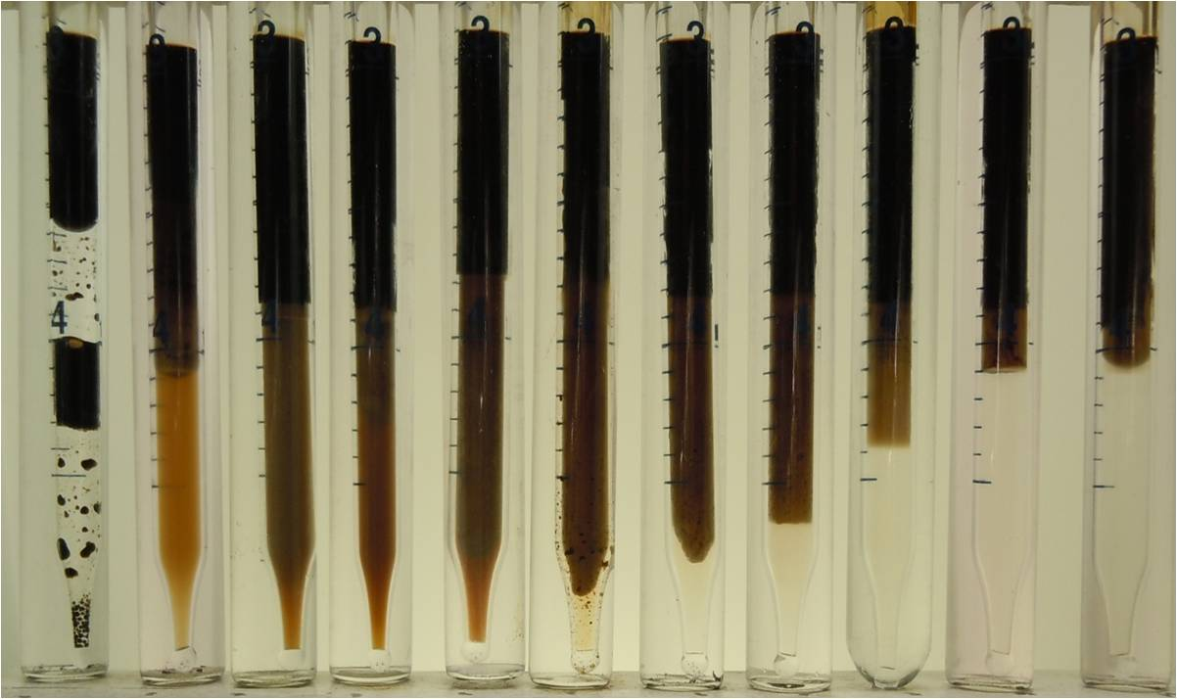
After equilibrated for 48 hours--at room temperature-77°F (25°C)
% Na₂CO₃ [Surfactant-Free Samples]
0 0.5 1.0 1.5 2.0 2.5 3.0 3.5 4.0 4.5 5.0
After equilibrated--at 130°F (52°C) for 1 week
% Na₂CO₃ [Surfactant-Free Samples]
0 0.5 1.0 1.5 2.0 2.5 3.0 3.5 4.0 4.5 5.0
Red arrow to indicate possible phase transition from O/W to W/O microemulsion
Notes:
Criterion for inversion; uncertainty may existed because of emulsion; extra brine phase; magnified picture can be clearly seen

Slide 10
NaOH
0-2% Wt/Wt

Slide 11
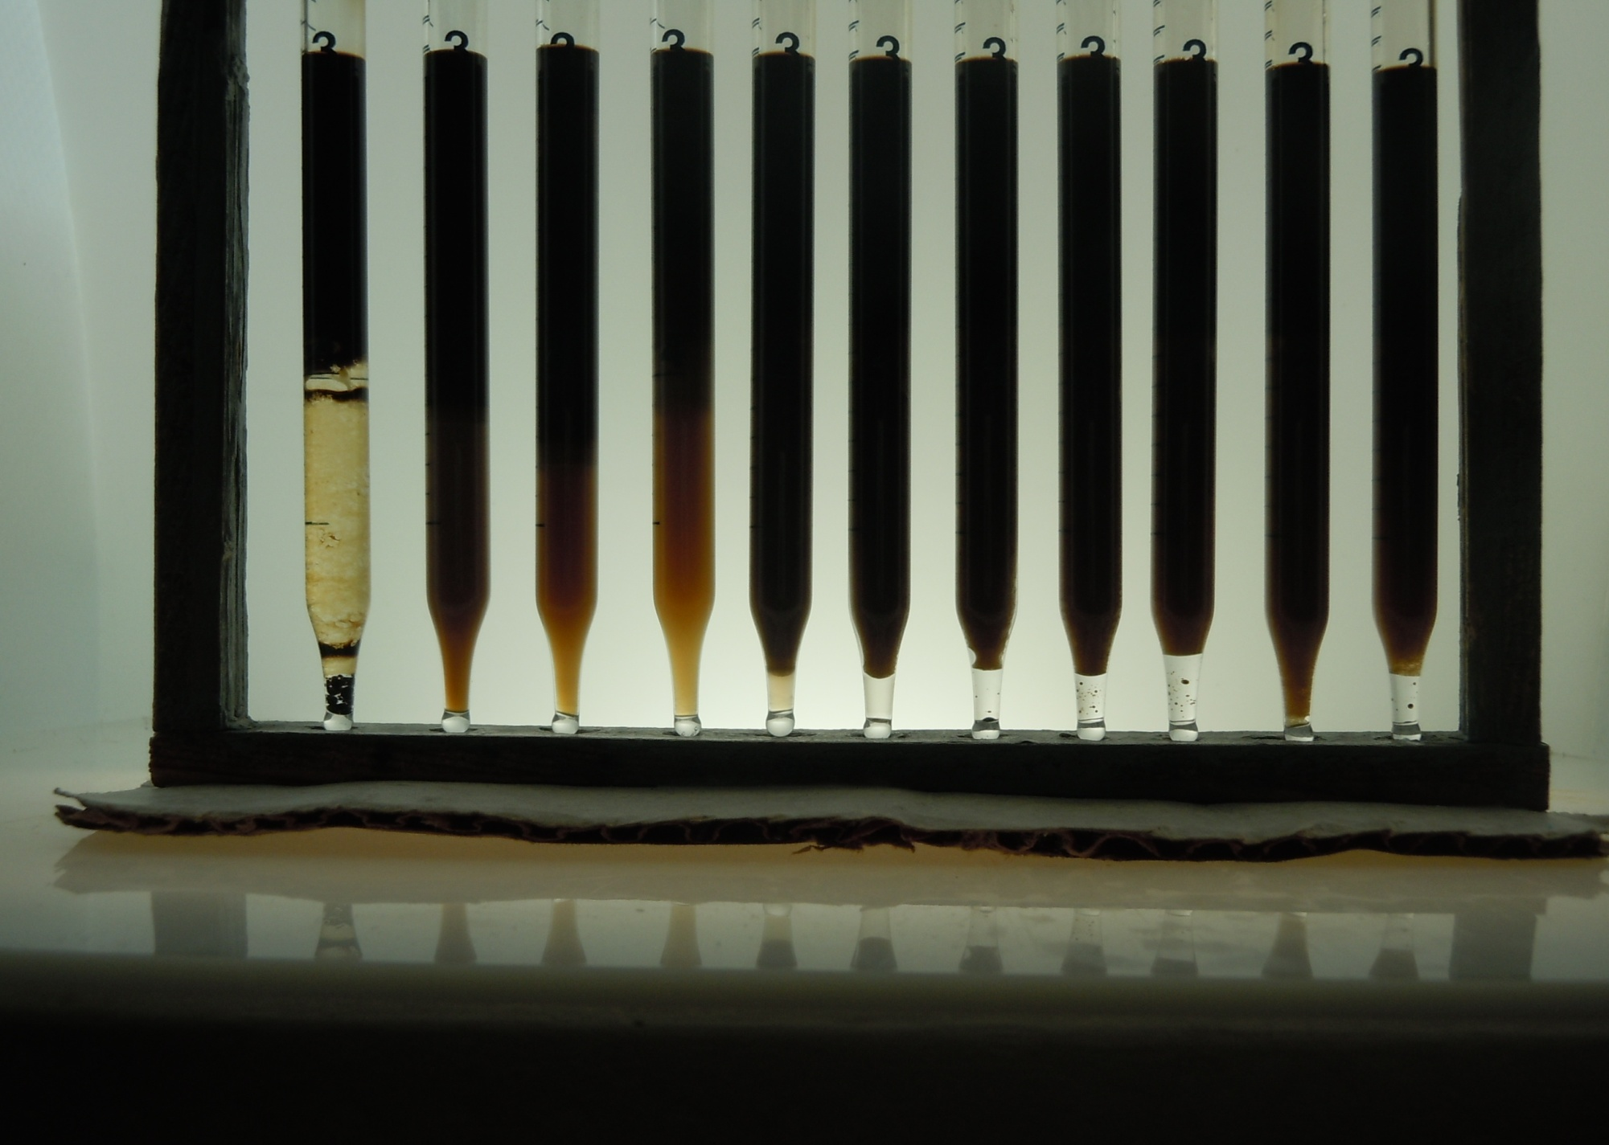
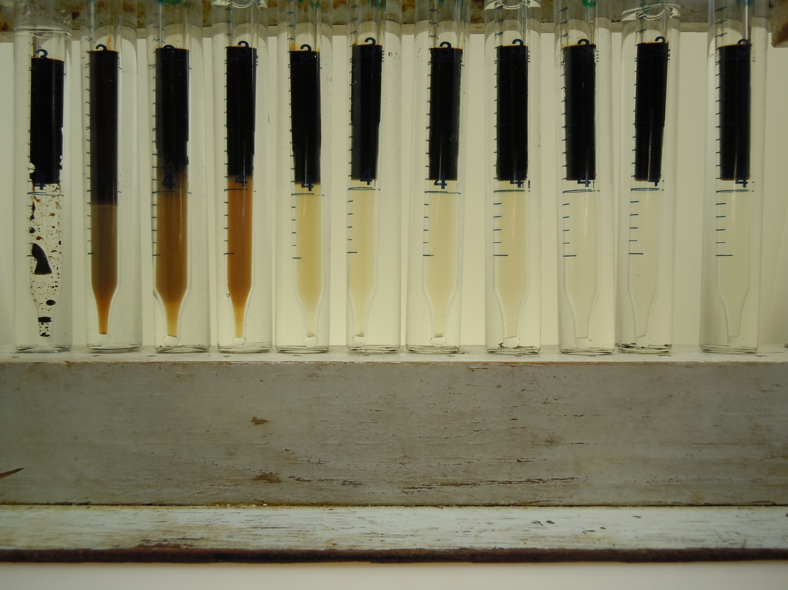
After equilibrated for 48 hours--at room temperature-77°F (25°C)
% NaOH [Surfactant-Free Samples]
0 0.2 0.4 0.6 0.8 1.0 1.2 1.4 1.6 1.8 2.0
After equilibrated--at 130°F (52°C) for -1 week
% NaOH [Surfactant-Free Samples]
0 0.2 0.4 0.6 0.8 1.0 1.2 1.4 1.6 1.8 2.0
Red arrow to indicate possible phase transition from O/W to W/O microemulsion
Notes:
The same criteria;

Slide 12
Summary of Test Results
Salinity for inversion point (Surfactant-Free Samples)
 |  | Room Temperature-25°C | 130°F (52°C)
Na2CO3 | % | 2.250 | 2.250
 | M(Na⁺) | 0.425 | 0.425
NaOH | % | 0.700 | 0.700
 | M(Na⁺) | 0.175 | 0.175
No effect of temperature seen
Higher inversion Na⁺ Molar Concentration for Na₂CO₃
Notes:
No effect of NaCl; no effect of temperature; in-situ soap produced by alkali is anionic surfactant; hydroxyl

Slide 13
In the Presence of Surfactant
Overall surfactant concentration 0.25%, 0.5%, 1%
NaCl 0-5% Wt/Wt
Na₂CO₃ 0-5% Wt/Wt
NaOH 0-2% Wt/Wt

Slide 14
Procedures with Surfactant Present
Phase behavior of blend of ionic surfactants, PO sulfate and IOS, at different concentration, in the presence of dead crude oil and either Na₂CO₃ or NaOH was determined. The surfactant was recommended to sponsor by another organization.
Samples were
first rotated end-to-end for 24 hours,
immersed in tubes filled with water,
located in water bath at 130°F,
mixed daily, many times, for at least two days,
and left standing before taking photos.
Notes:
Fixed blend ratio; Different concentration, 1%, 0.5%, 0.25%;

Slide 15
NaCl
0-5% Wt/Wt

Slide 16
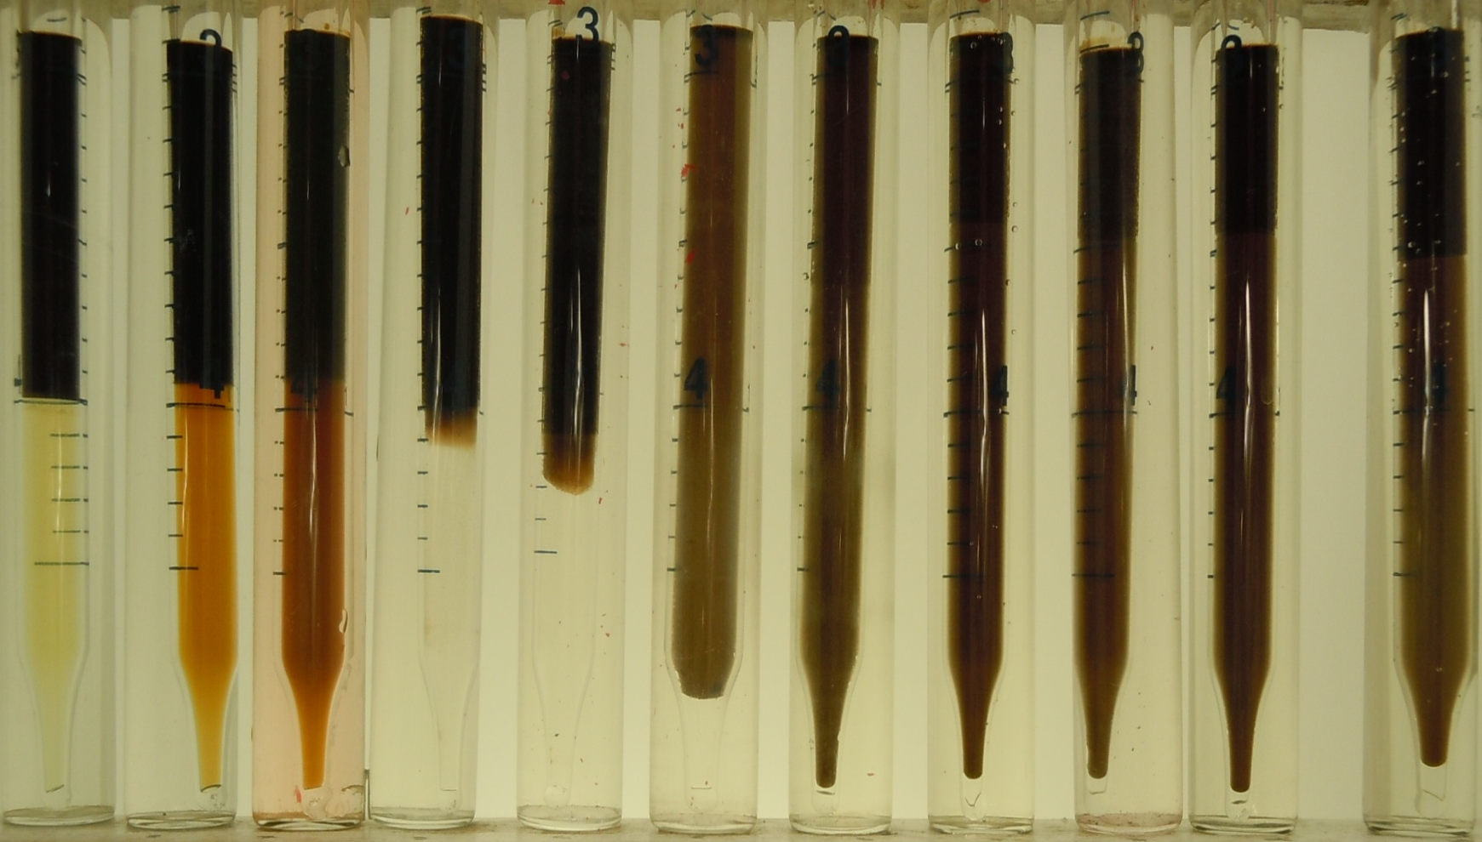
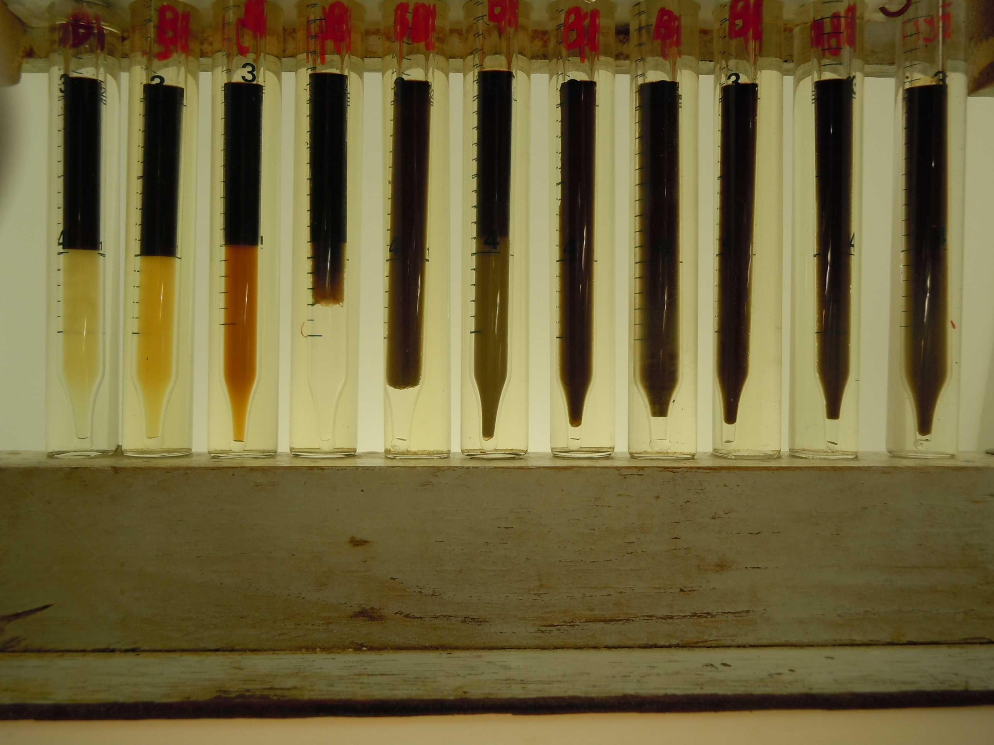
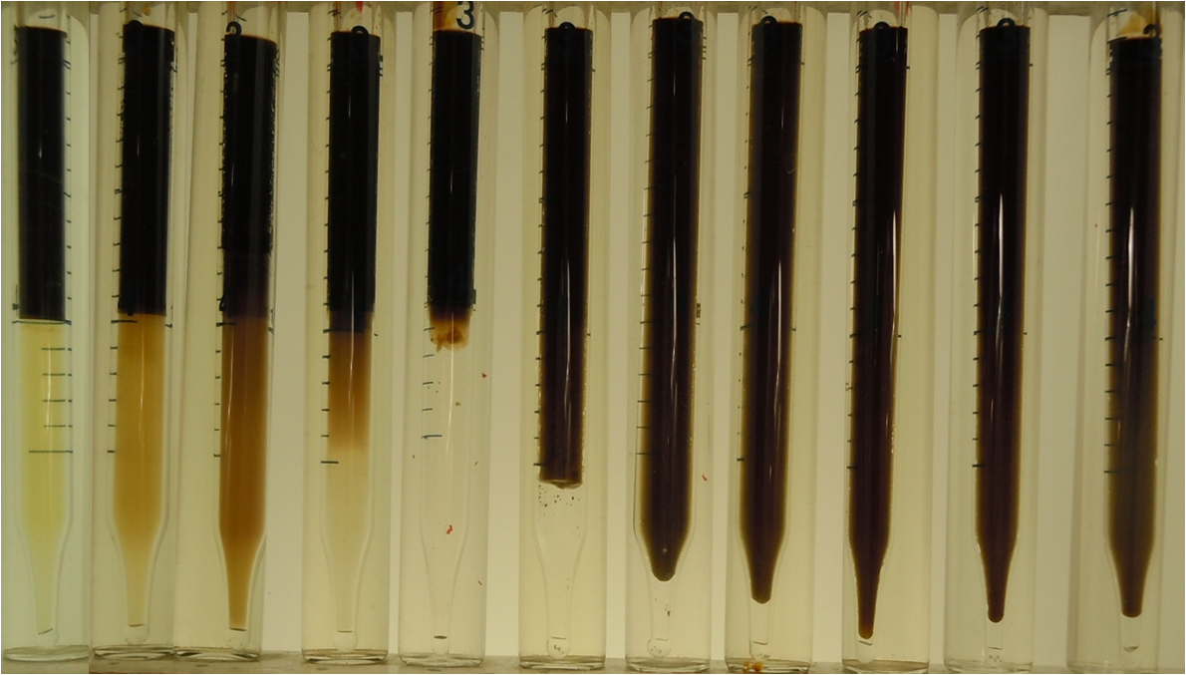
0 0.5 1.0 1.5 2.0 2.5 3.0 3.5 4.0 4.5 5.0
% NaCl at 130°C _52 °C
1% overall Surfactant concentration
0.5%
0.25%
After equilibrated_ 1 week
INVERSION POINT
CONCENTRATION
INDEPENDANT
Red arrow to indicate possible phase transition from O/W to W/O microemulsion
16

Slide 17
Na₂CO₃
0-5% Wt/Wt

Slide 18
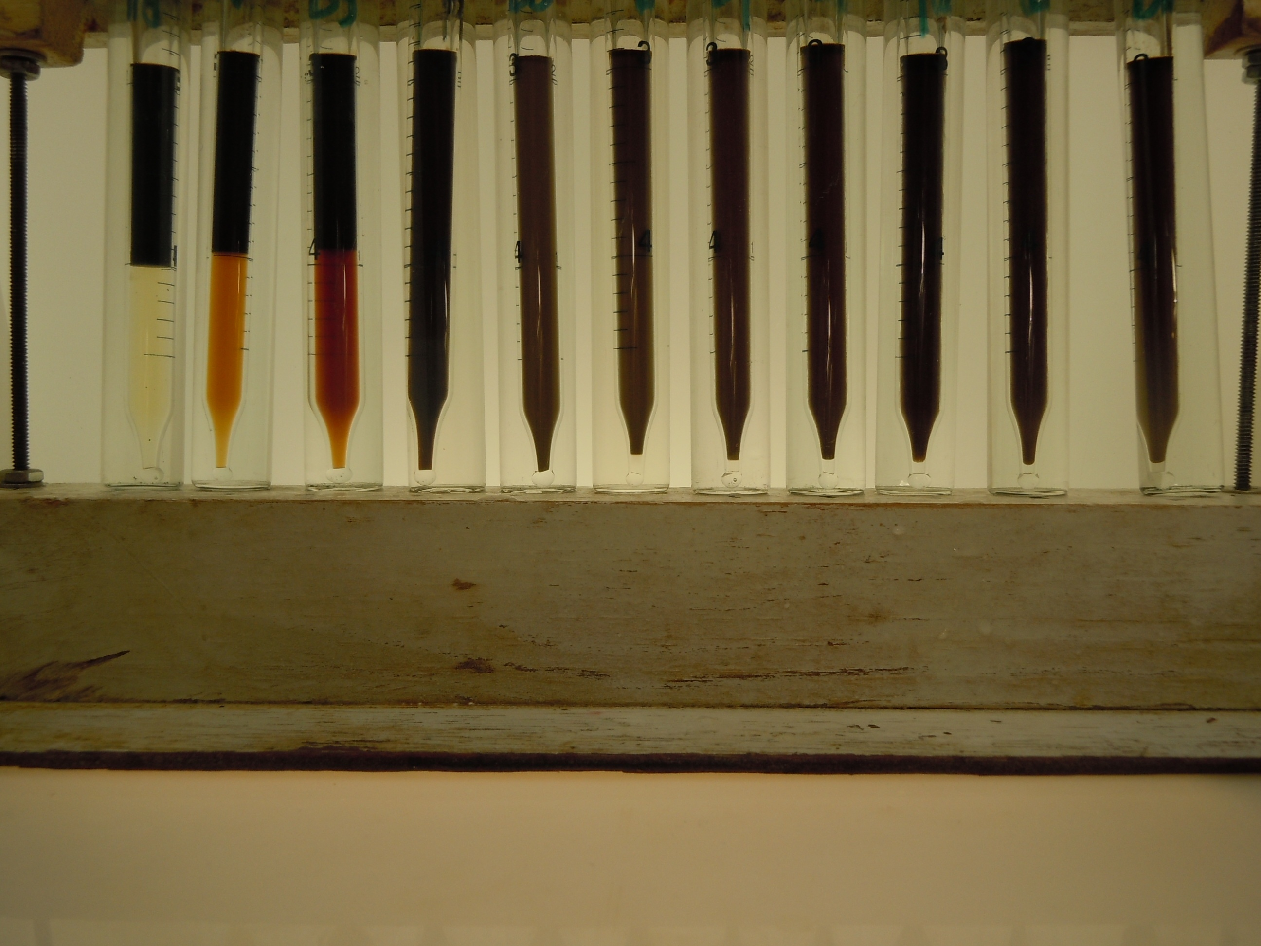
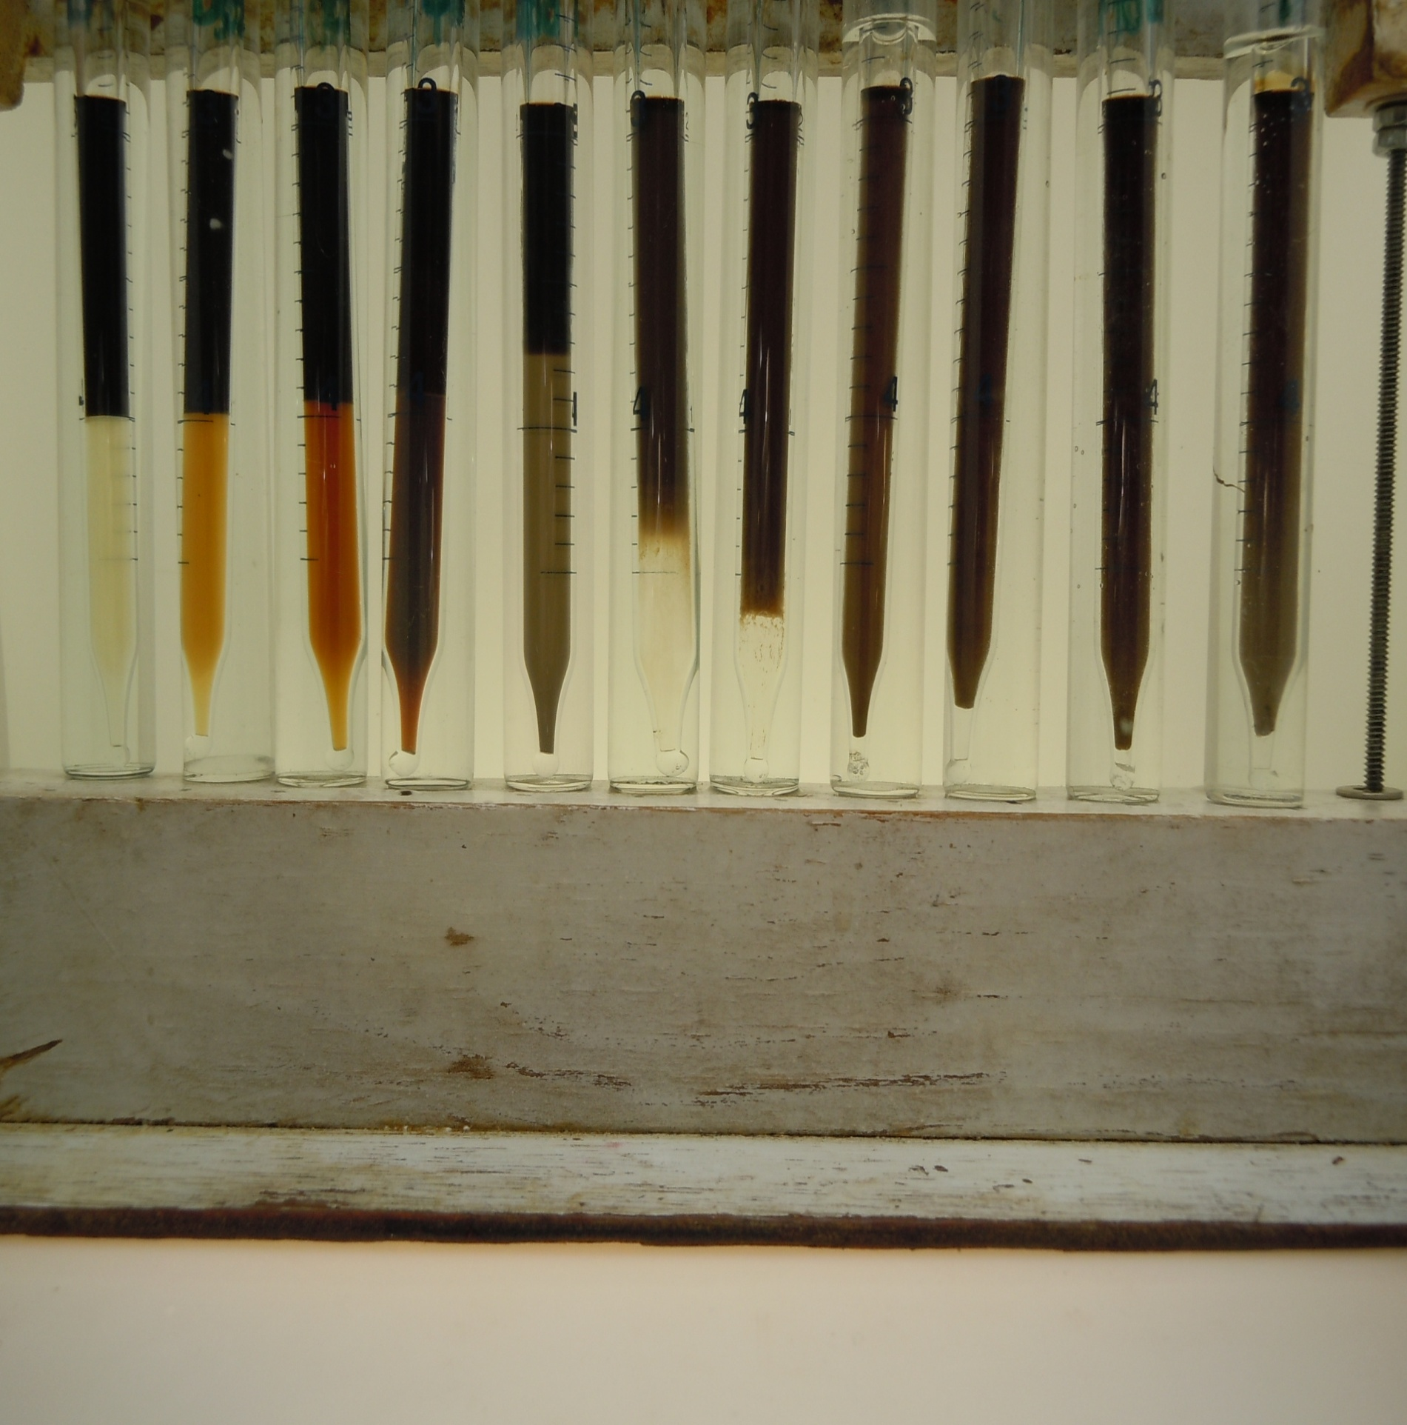
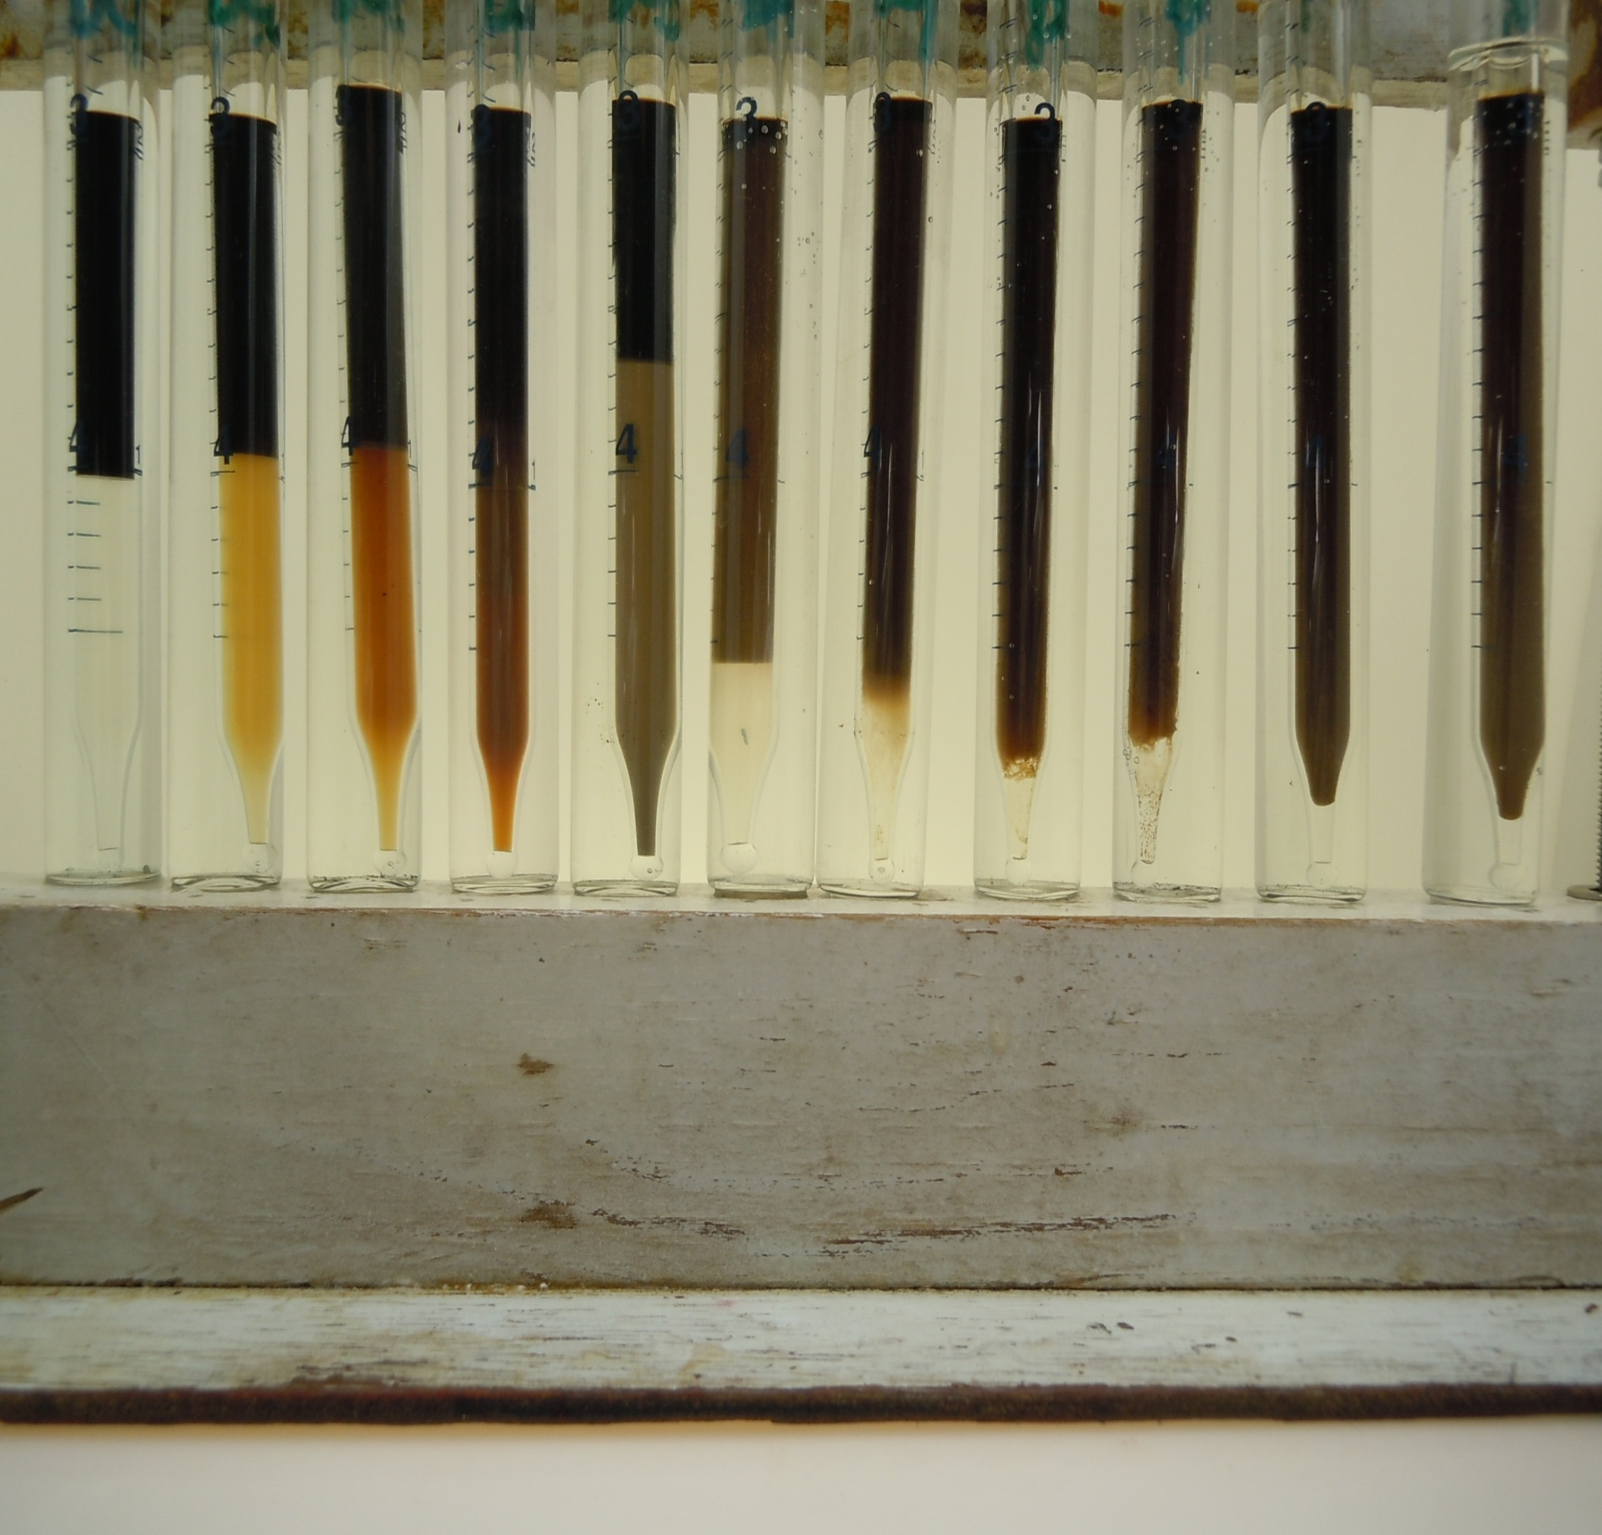
0 0.5 1.0 1.5 2.0 2.5 3.0 3.5 4.0 4.5 5.0
% Na2CO3 at 130°C _52 °C
After equilibrated_ 1 week
1% overall Surfactant concentration
0.5%
0.25%
INVERSION POINT
CONCENTRATION
INDEPENDANT
Red arrow to indicate possible phase transition from O/W to W/O microemulsion

Slide 19
NaOH
0-2% Wt/Wt

Slide 20
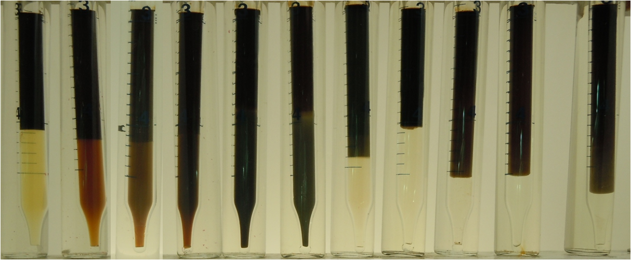
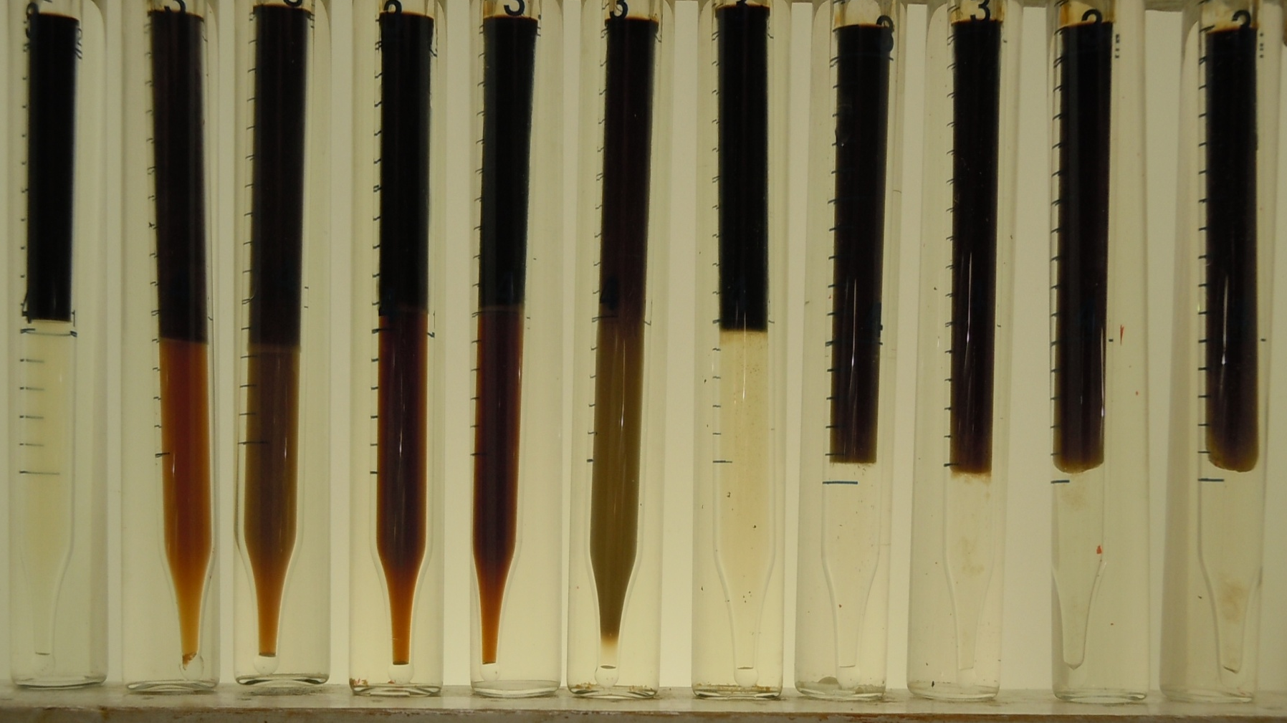
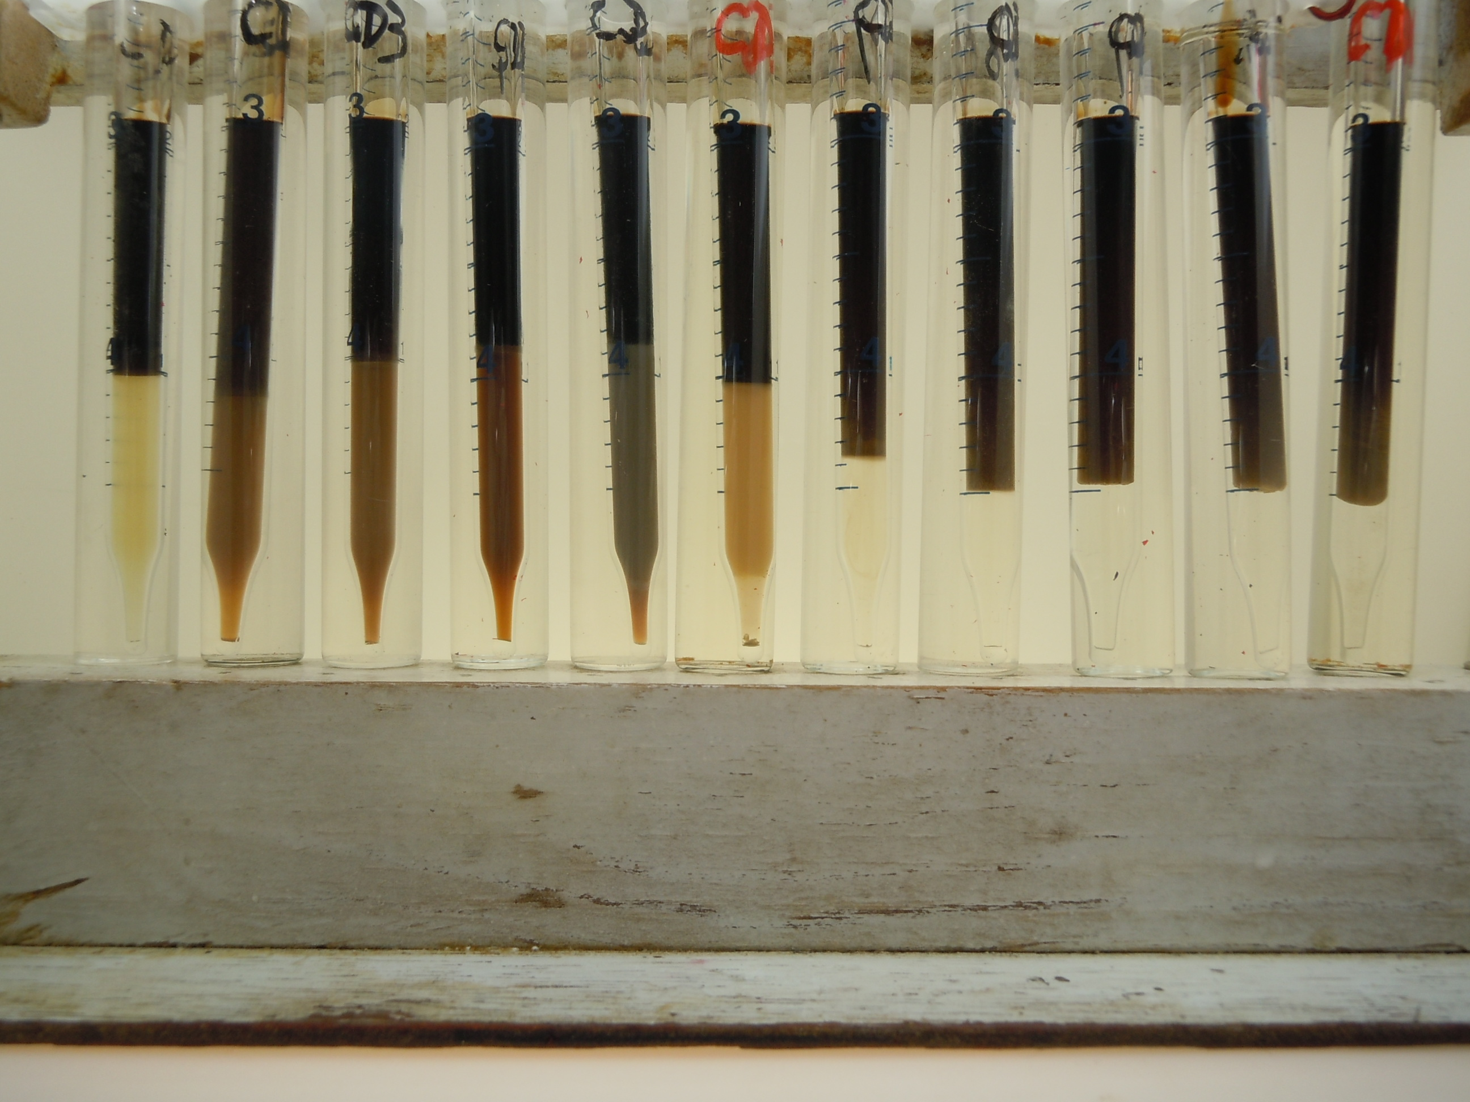
0 0.2 0.4 0.6 0.8 1.0 1.2 1.4 1.6 1.8 2.0
After equilibrated_ 1 week
1% overall Surfactant concentration
0.5%
0.25%
% NaOH at 130°C _52 °C

Slide 21
Summary of Test Results
Notes:
Why M Na+; anionic surfactant, the counterions for an anionic surfactant film and are hence more important to phase behavior than anions Cl, CO3.Soap produced at low PH is more hydrophilic;

Slide 22
Outline
• Crude Oil Contamination Test
• Phase Behavior with NaOH and Na2CO3
Surfactant Free Samples
In the Presence of Surfactant
• Conclusion and Future Work

Slide 23
Conclusions
Oil tested appeared to have an Acid Number high enough to produce soaps in the presence of alkali
(2) The inversion points for phase behavior tests without surfactant were almost unaffected by increasing temperature from 77°F to 130°F
(3) For alkali scans with this crude oil in the absence of surfactant, molar concentration M_{Na+} of Na⁺ ions at the inversion point is much greater for Na₂CO₃ than for NaOH

Slide 24
Conclusions
(4) M_{Na+} for inversion with surfactant alone is less than that with Na₂CO₃ alone, the opposite of the usual situation for ASP, where soap is more hydrophobic than surfactant
(5) M_{Na}⁺ for inversion with surfactant alone is similar to that with NaOH alone
(6) This surfactant may not be the best choice if AS or ASP is to be used

Slide 25
Future Work
To measure IFT with alkali and/or surfactant (Ultralow value?)
To investigate the influence of soap produced by NaOH and Na₂CO₃ on phase behavior test in model system (Oleic acid; N-Octane)
To determine the best SP or ASP processes for this crude oil in its reservoir
Notes:
THIS SURFACTANT MAY NOT BE THE BEST CHOICE IF ASP IS TO BE USED

